Slide 1

Customer Analysis in the Marketing Strategy of Huawei
Peijin Li
May 2nd, 2023
Notes:
Hi everyone, for the final project I am working on Huawei Social Network and the main purpose of this study is to see the pattern of how Huawei consumers connected/ So this study is conducted by analyzing the social network data on mainstream social media platforms, such as Facebook, Twitter, and Instegram. These three platforms are the main platform where Huawei advertise their products and services.

Slide 2
Social Network Data
Data Source: Huawei Social Network Data
Huawei Facebook Communication Network is Directed and Labeled having 1000 nodes and 250315 edges
Huawei Twitter Communication Network is Directed and Labeled having 1000 Nodes and 50153 edges
Huawei Instagram Communication Network is Directed and Labeled having 1000 Nodes and 4933 edges
Data Collection
This Network was collected by crawling the Huawei’s social media platforms - Facebook, Twitter and Instagram.
Thus this network has three layers. NLP techniques are used to took only positive reviews from posts and after that data is preprocessed.
Notes:
So the data source I use is Huawei Social Network Data. It is available on the Kaggle platform and the dataset includes 1000 nodes from each of the platform, including Facebook, Twitter and Instagram.The data is extracted from the API of these three platforms, and is collected from the Facebook posts, twitter tweets and Instagram posts and comments under the Huawei official account. So if a user leave a message sharing a positive comment under the topic, there will be a 1 marking the communication network between the two people.

Slide 3
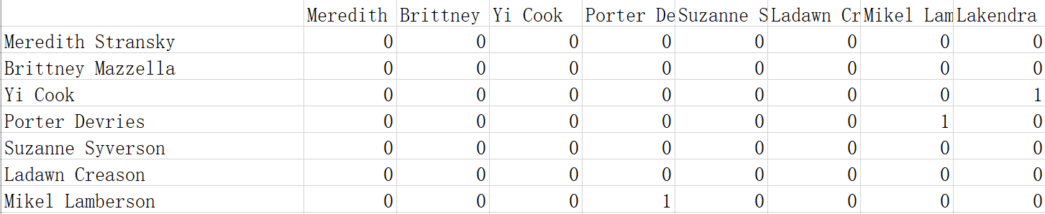
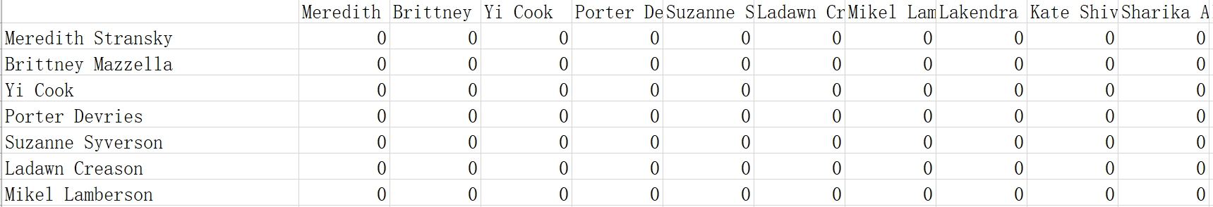
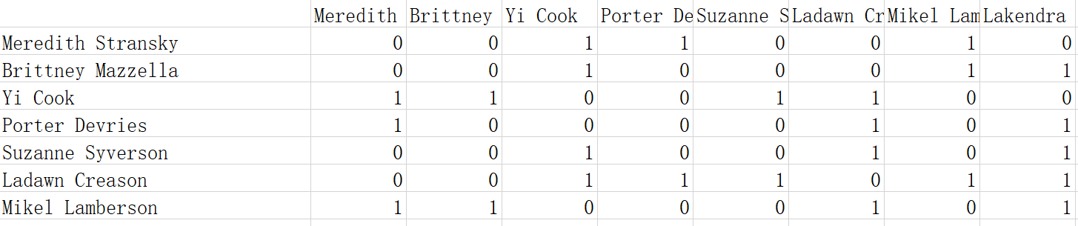
Data
Facebook Data
Instagram Data
Twitter Data
Notes:
Thus this network has three layers. and Each of the platform has the same subset of users, so it provides with the potential possibility of studying user’s different connecting behaviour by comparing the connecting patterns of these three platforms.

Slide 4
Context
Huawei Technologies Co.Ltd. is a Chinese multinational networking, telecommunications equipment, and services company headquartered in Shenzhen, Guangdong. It is the largest telecommunications equipment manufacturer in the world, having overtaken Ericsson in 2012.
In 2014, Huawei recorded a profit of 34.2 billion CNY (5.5 billion USD). Its products and services have been deployed in more than 170 countries and it currently serves 45 of the world's 50 largest telecoms operators.
From July to September 2017, Huawei surpassed Apple and became the second largest smartphone manufacturer in the world after Samsung.
Notes:
Before the analysis part, there is a brief introduction about the context of this project and provide some information about Huawei. So Huawei is a chinese telecommunications equipment and services company. And It is the largest telecommunications equipment manufacturer in the world, and Its products and services have been deployed in more than 170 countries.

Slide 5
Customer Analysis in the Marketing Strategy of Huawei through Social Network Analysis
Social Media Analysis Helps the Huawei Company to improve their businesses form the following ways :
Grow the business and evaluate the impact of marketing campaigns.
Make better business decisions and build a strong strategy.
Improve customer experience and satisfaction and build brand awareness.
Social media analytics helps Huawei organizations understand their targeted audience.
Social media analytics can increase engagement and responsiveness.
Social media analytics to measure and improve brand awareness.
Social media analytics can highlight problems and weaknesses to discover new trends and avoid a brand crisis.
Social media analytics can help you learn from the competitors.
Notes:
One of the Major success behind Huawei Company is that they promote their products through Social Media. Social media analysis helps Huawei better understand their targeted audience, evaluate the impact of marketing campaigns and enhance their business.

Slide 6
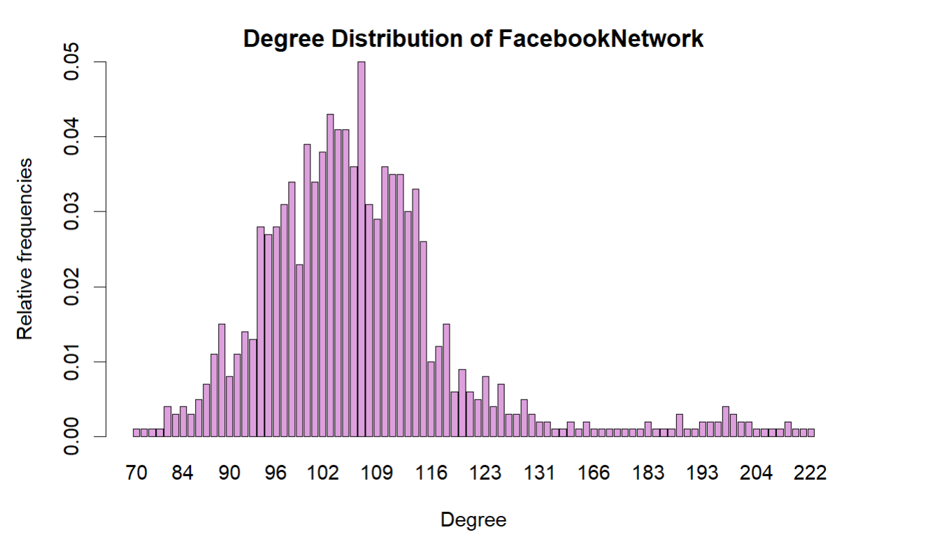
Exploratory Data Analysis
The average degree of Facebook Network is 108.874
The density of Facebook Network is 0.108983
The member with the highest betweenness centrality is 36
Notes:
So far I conducted some eda based on these three dataset, and as we can see, Twitter network has the highest average degree, 500,63, instagram has the lowest, only around 10. Twitter has the highest density with 0.5. So it seems Twitter to be the platform where the users have the most connects, indicating Twitter could be the best platform to launch a marketing campaign.

Slide 7
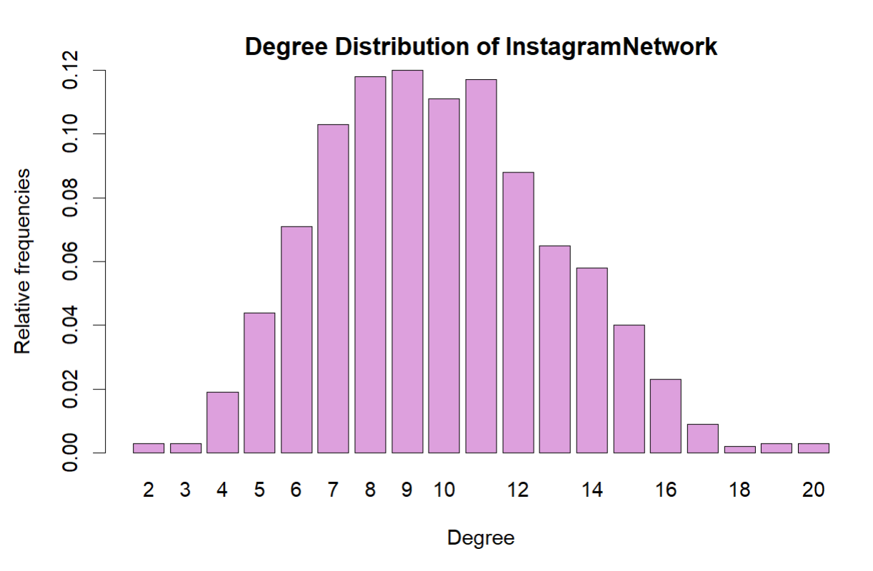
Exploratory Data Analysis
The average degree of Instagram Network is 9.866
The density of Instagram Network is 0.009875876
The member with the highest betweenness centrality is 698
Notes:
So far I conducted some eda based on these three dataset, and as we can see, Twitter network has the highest average degree, 500,63, instagram has the lowest, only around 10. Twitter has the highest density with 0.5. So it seems Twitter to be the platform where the users have the most connects, indicating Twitter could be the best platform to launch a marketing campaign.

Slide 8
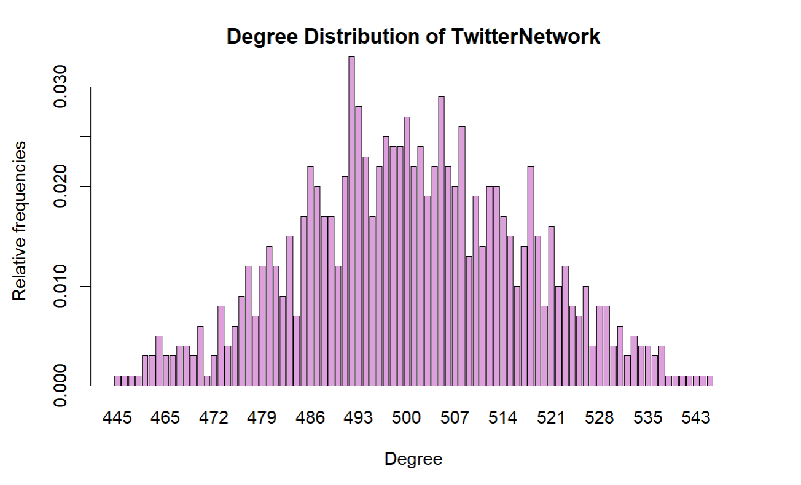
Exploratory Data Analysis
The average degree of Twitter Network is 500.63
The density of Twitter Network is 0.5011311
The member with the highest betweenness centrality is 193
Notes:
So far I conducted some eda based on these three dataset, and as we can see, Twitter network has the highest average degree, 500,63, instagram has the lowest, only around 10. Twitter has the highest density with 0.5. So it seems Twitter to be the platform where the users have the most connects, indicating Twitter could be the best platform to launch a marketing campaign.

Slide 9
Further Analysis and Explorations
Potential Tools
Centrality Analysis
Exponential Random Graph Models
PageRank
Research Question
What is the clustering features in each of the social median platform and who are the influential nodes in the network?
What is the difference of connection in different groups of people (gender/race).
Notes:
for further study, analysis, I also plan to I also plan to use methods such as centrality analysis and Exponential Random Graph Models to explore the pattern of user’s connections on these platforms and I may also employ PageRank to identifying influential nodes in the network. And by comparing different user connection pattern, we could learn the difference of people’s behavior on each platform, which may be helpful for company to set the marketing strategy. So for the next step study, I will dig deeper and look into What is the clustering features in each of the social median platform, whether there is some special pattern and who are the influential nodes in the network? And with the name of the user available, there is a possiblity to explore the potential difference of connection behavior among races and gender.

